Slide 1
Applications of Convolutional Neural Network

Slide 2
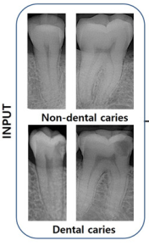
Application 1: Medicine
Accurate detection and diagnosis of dental caries reduces the cost of oral health management, and increases the likelihood of natural tooth preservation in the long term.
OBJECTIVE: Detection and Diagnosis of dental caries from Radiographs
INPUT = Periapical radiographic images consisting of Non-Dental caries and Dental Caries
OUTPUT = Classification between dental caries and non-dental caries.
Ref: Detection and diagnosis of dental caries using a deep learning-based convolutional neural network algorithm, 2018 (doi: 10.1016/j.jdent.2018.07.015)

Slide 3
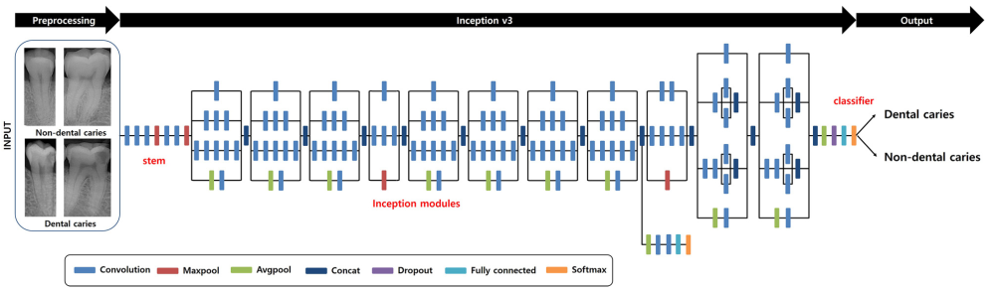
Application 1: Medicine
Network Architecture:

Slide 4
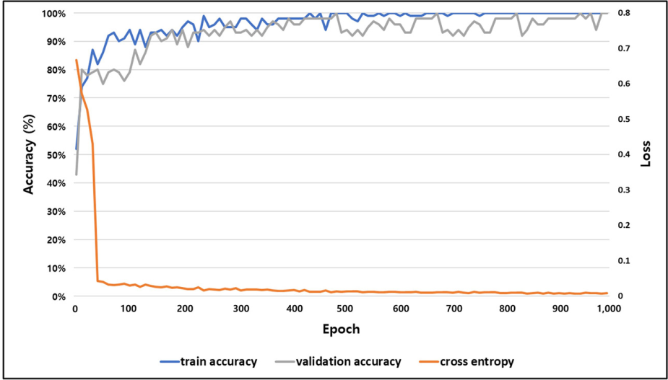
Application 1: Medicine
Graph of Accuracy and loss(Cross entropy) during Training and Validation:

Slide 5
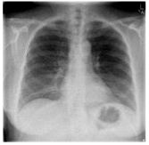
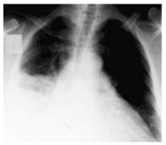
Application 2: Medicine
To improve the efficiency of radiologists, CNNs are used to preprocess the thorax (chest) radiographic images and filter out the images taken from healthy persons. Only those images suspected abnormal will be further checked by doctors. It would save the time of doctors significantly since most of the chest x-ray images (e.g., 70-80%) are from healthy people.
OBJECTIVE: Diagnosis of Thorax disease
INPUT: CT images for thorax which have been labeled, i.e., either from a healthy or potential unhealthy person.
OUTPUT: Classification of images as from healthy or Unhealthy person
Ref: Thorax disease diagnosis using deep convolutional neural network, 2016 (doi: 10.1109/EMBC.2016.7591186)
Healthy person
Unhealthy person

Slide 6
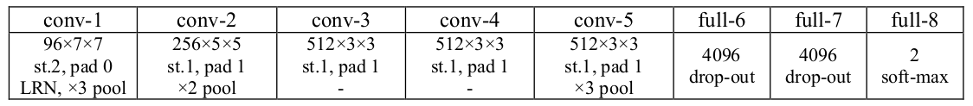
Application 2: Medicine
Network Architecture:

Slide 7


Application 3: Biology
Identifying phenotypes based on high-content cellular images is challenging. Conventional image analysis pipelines for phenotype identification comprise multiple independent steps, with each step requiring method customization and adjustment of multiple parameters
OBJECTIVE: classification of cellular images into phenotypes using CNNs
INPUT: Microscopy cellular Images
OUTPUT: Probability outputs calculated by the network to quantitatively describe the phenotypes for the cellular images.
Ref: A multi-scale convolutional neural network for phenotyping high-content cellular images, 2017 (doi: 10.1093/bioinformatics/btx069)
Input Image
Phenotype Probability

Slide 8
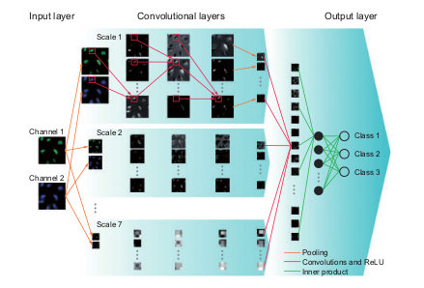
Application 3: Biology
Network Architecture:

Slide 9
More Applications: MEDICINE
CNNs are applied to radiological images for predicting clinically useful information, such as the detection and evaluation of lesions etc.
Deep learning with convolutional neural network in radiology (https://doi.org/10.1007/s11604-018-0726-3)
By using a large dataset of images of labeled tissues, a deep CNN can classify skin cancer with almost the same accuracy as a dermatologist
The application of convolutional neural network to stem cell biology (https://doi.org/10.1186/s41232-019-0103-3)
CNNs are used to segment heart sounds into their main Components.
Deep Convolutional Neural Networks for Heart Sound Segmentation (DOI 10.1109/JBHI.2019.2894222)

Slide 10
More Applications: BIOLOGY
The development of CNN enables the automation of identifying cell types from phase contrast microscope images without molecular labeling, which will be applied to several researches and medical science.
The application of convolutional neural network to stem cell biology (https://doi.org/10.1186/s41232-019-0103-3)
In Genomics, CNNs are used to detect a motif wherever it is in the sequence window, which perfectly suits the task of motif identification and hence binding classification.
Convolutional neural network architectures for predicting DNA–protein binding (doi: 10.1093/bioinformatics/btw255)
Prediction of protein residue–residue contacts
DNCON2: improved protein contact prediction using two-level deep convolutional neural networks (doi: 10.1093/bioinformatics/btx781)

